Slide 1
E-Commerce Platform Analysis
E-retail factors for customer activation and retention: A case study from Indian e-commerce customers

Slide 2
Problem Statement
The case study identified five factors that contribute to the success of an e-commerce store:
Service quality
System quality
Information quality
Trust
Net benefit
On the basis of above points, the data is collected from the Indian online shoppers to investigate the factors that influence the online customers repeat purchase intention.
To give findings and conclusions in detailed data analysis from the given dataset

Slide 3
About the dataset
The dataset contains 269 observations with 71 columns in each observation
Column 1 to Column 6 - contains customer information
Column 7 to Column 15 - contains the way to access the online shopping platform
Column 16 and Column 17 - tells the reason of abandoning the shopping cart
Column 18 to Column 47 - contains customer experience of online shopping
Column 48 - tells about preferred online – retailer shopped in the past
Column 49 to Column 61 - tells about the performance of the online-retailers
Column 62 to Column 70 - tells about the bad experiences of the online-retailers
Column 71 - Recommendation to friend the preferred online-retailer (target/label)

Slide 4
Initial Observations
The dataset contains 269 rows and 71 columns.
The given dataset has no missing values in the observations.
All the columns are of object data type except pin code column.
On checking unique values of the columns, we observe that all the columns are categorical in nature.
As far as columns heading is concerned, it consist of tab spaces, digits, leading and trailing spaces which need to be handled.

Slide 5
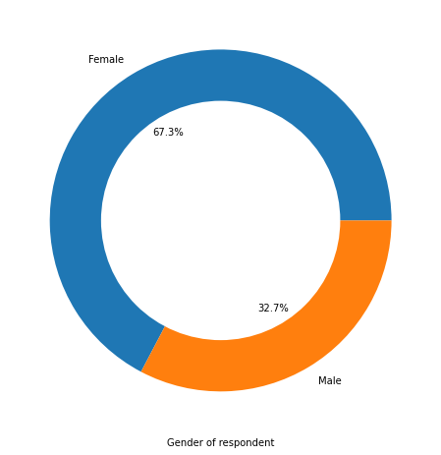
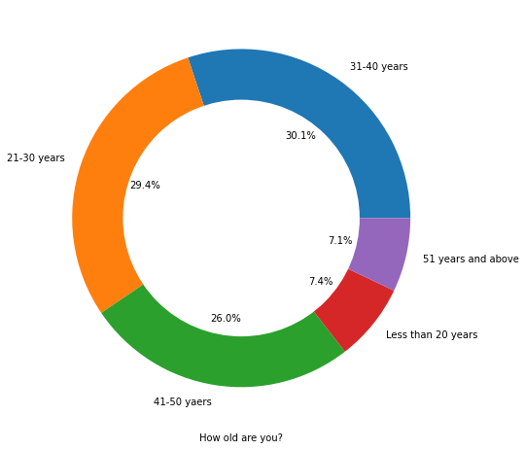
Univariate Analysis
First six columns of the dataset contains customer information like gender, age, city, Pin code, duration of doing online shopping and how many times a customer shop online in a past year.
All are categorical columns, analysis of first five columns using Pie chart
Double the number of women than men have taken this survey
Most of the people are in their 30's followed by 20's, teenagers and senior citizen are the least in number

Slide 6
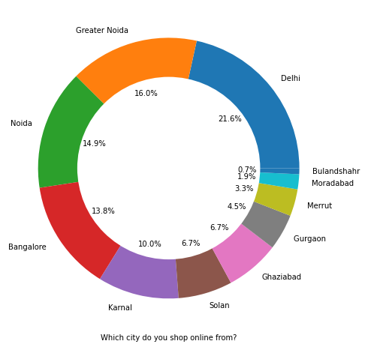
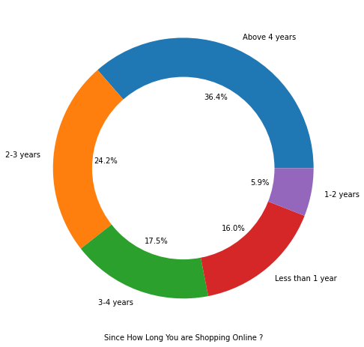
Univariate Analysis
For city and frequency of online shopping, analysis using Pie chart
Most of the people belong from Delhi, Noida and Bangalore
Approx. 37% of people have been shopping from a long time

Slide 7
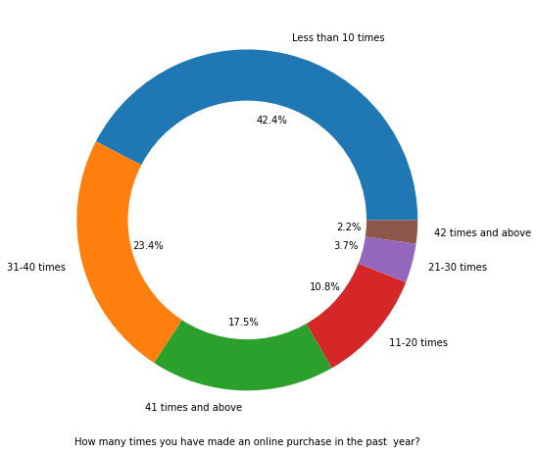
Univariate Analysis
For frequency a customer shop online in a past year, analysis using Pie chart
Majority of people , almost 58% shop online 10 times a year

Slide 8
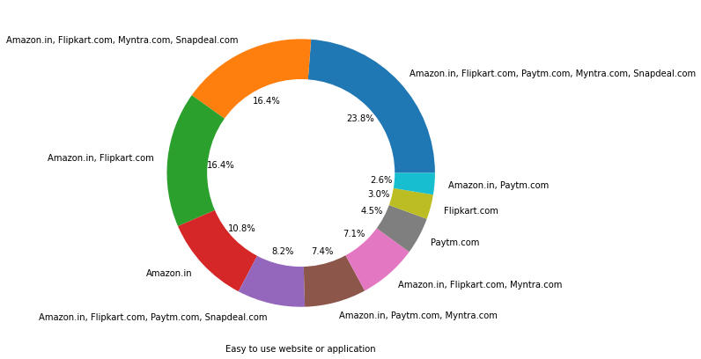
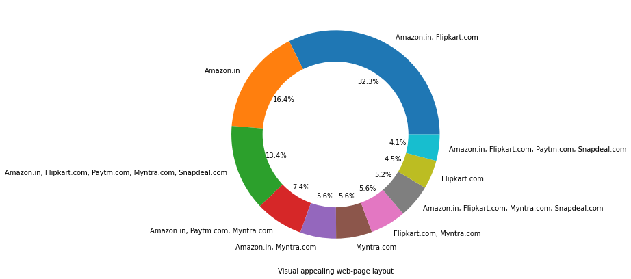
Univariate Analysis
For Column 49 to Column 61 which tells about the performance of the online-retailers
, analysis of brand image using Pie chart
Majority of people think almost all online retailers have website or application which is easy to use
Majority of people think Amazon and Flipkart has visual appealing web-page layout

Slide 9
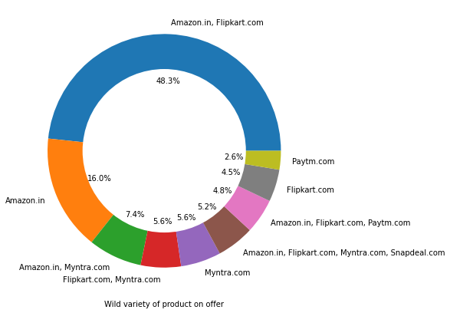
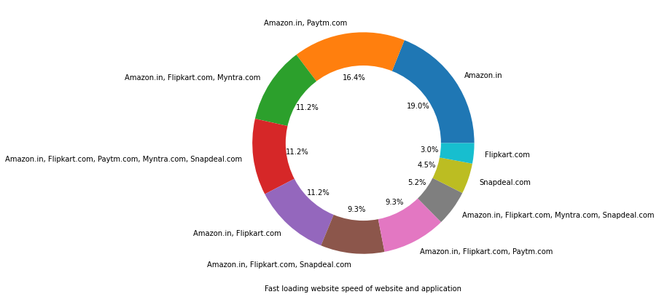
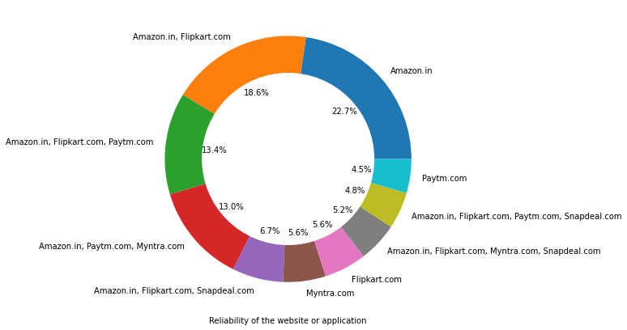
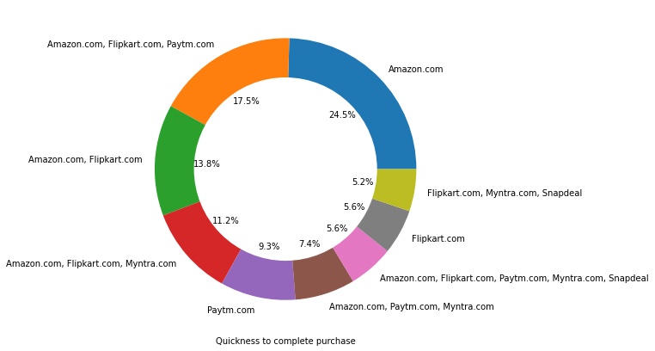
Univariate Analysis
For Column 49 to Column 61 which tells about the performance of the online-retailers
, analysis of brand image using Pie chart
Amazon and Flipkart gains maximum vote for all performance parameters

Slide 10
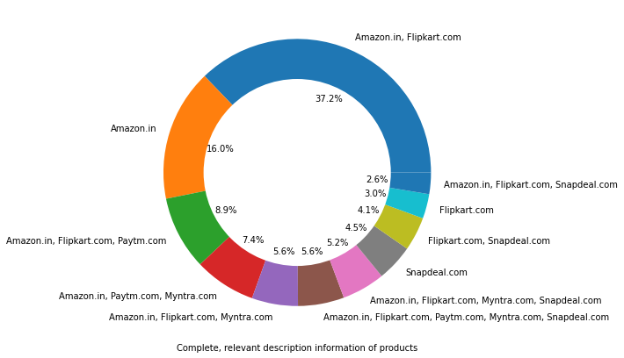
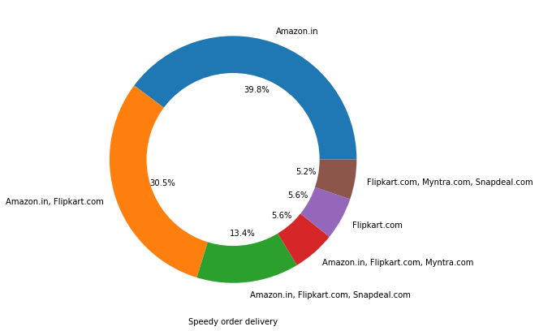
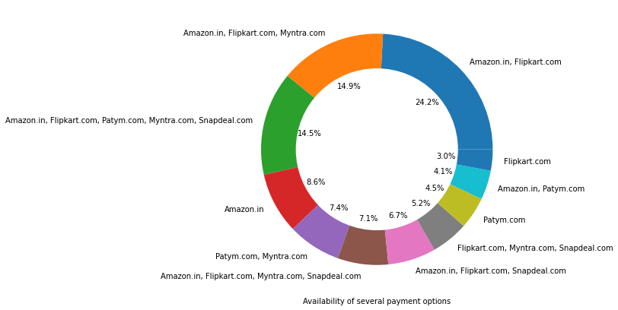
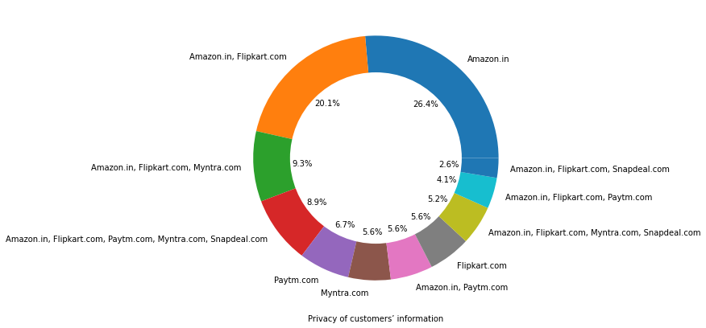
Univariate Analysis
For Column 49 to Column 61 which tells about the performance of the online-retailers
, analysis of brand image using Pie chart
Amazon and Flipkart gains maximum vote for all performance parameters

Slide 11
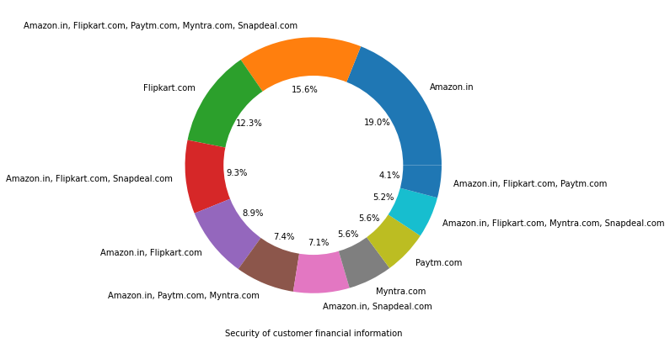
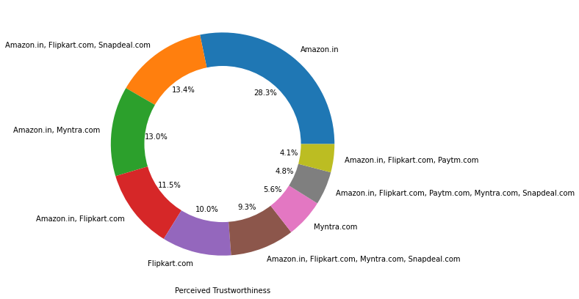
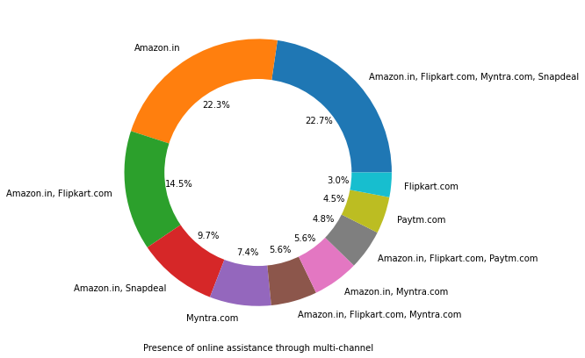
Univariate Analysis
For Column 49 to Column 61 which tells about the performance of the online-retailers
, analysis of brand image using Pie chart
Amazon, Flipkart have been had the highest votes for having all the positive points and have maintained a very good brand image followed by Paytm and the Myntra

Slide 12
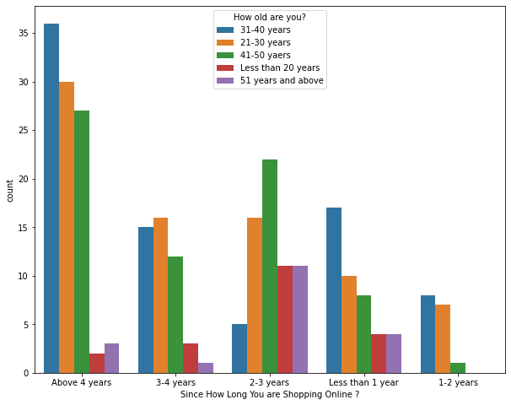
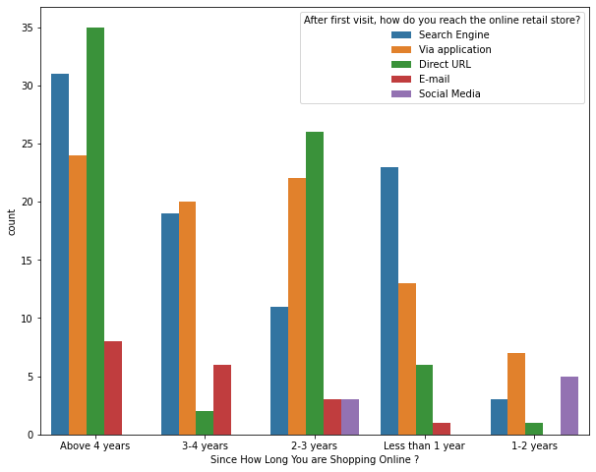
Bivariate Analysis
Highest number of people(age group 20’s, 30’s and 40’s) have been shopping online for above 4 years except for the age group below 20 years and above 50 years
People who are shopping online for 1-2 years does not include teenagers and elder people
Even though people who are shopping online for more than 4 years do not use the application rather use search engine and direct Url's in large number which indicates that online brands should update all their platforms rather than just application

Slide 13
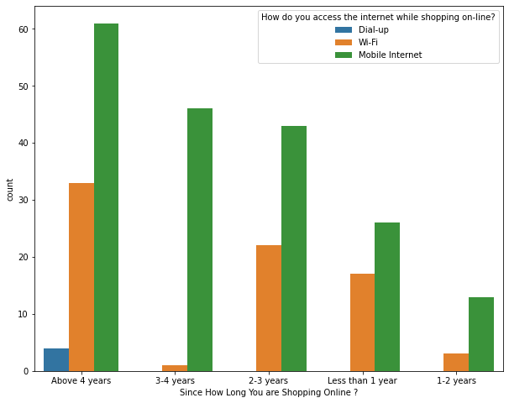
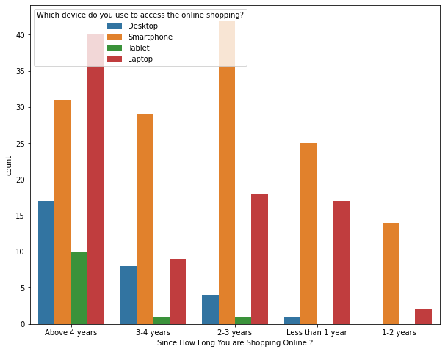
Bivariate Analysis
Majority of online shoppers use Mobile Internet to access the internet while shopping online
Smartphone is the major device use to access the online shopping

Slide 14
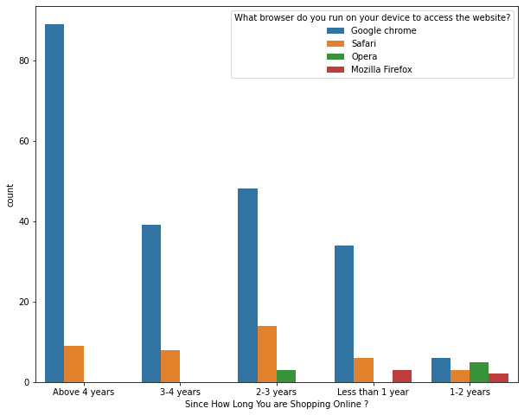
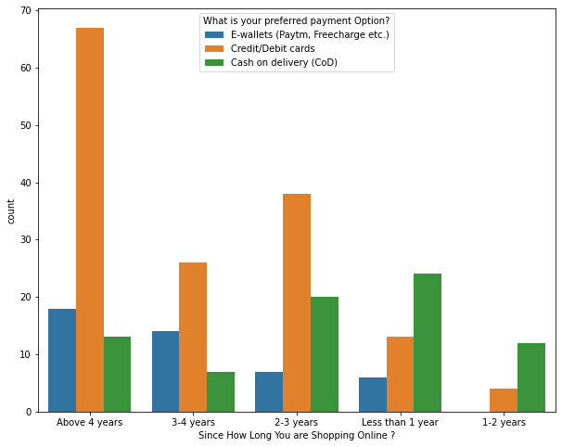
Bivariate Analysis
Majority of online shoppers use Google Chrome browser on their device to access the website
Majority of online shoppers use Credit/Debit cards as their preferred payment option

Slide 15
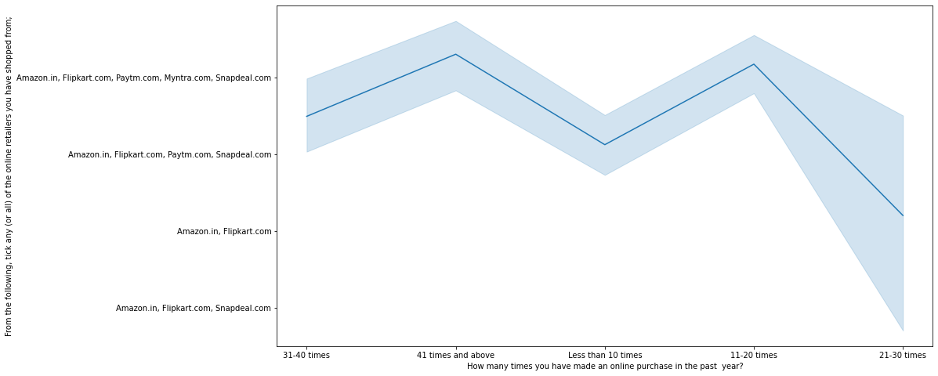
Bivariate Analysis
Heavy shoppers who shop more than 41 times a year shop from all the online brands
Some of the people who shop for 31-40 and less than 10 times a year seem to exclude Myntra
People shop from Amazon and Flipkart whatever be the case

Slide 16
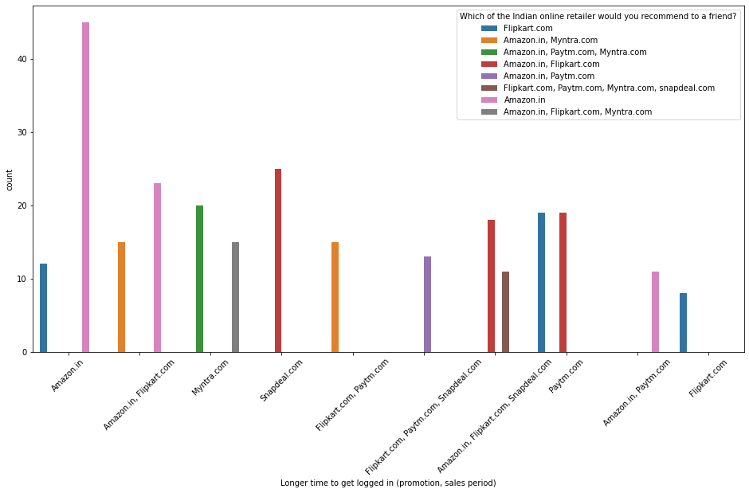
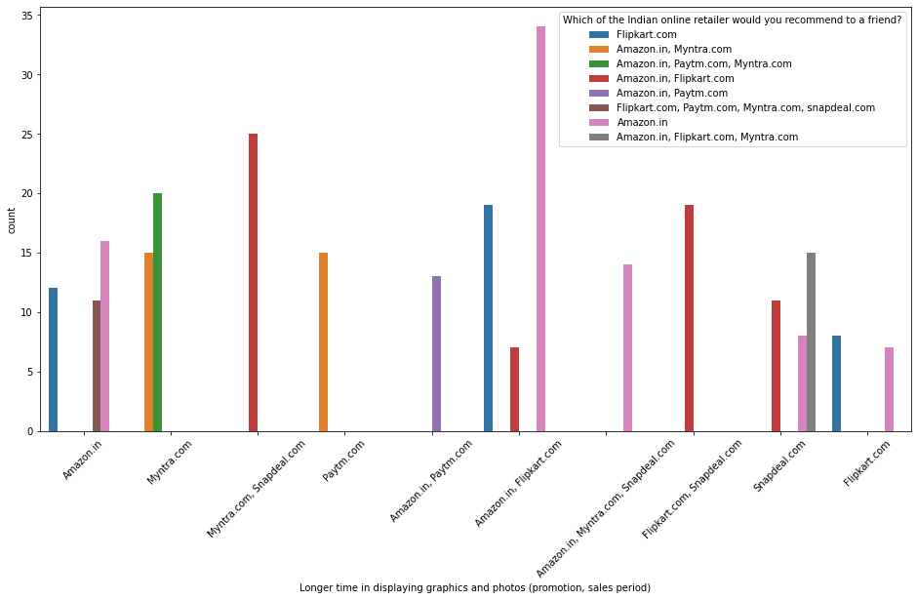
Bivariate Analysis
Amazon, Flipkart and Snapdeal takes longer time in displaying graphics and photos
Amazon & Flipkart is taking longer time to get logged in

Slide 17
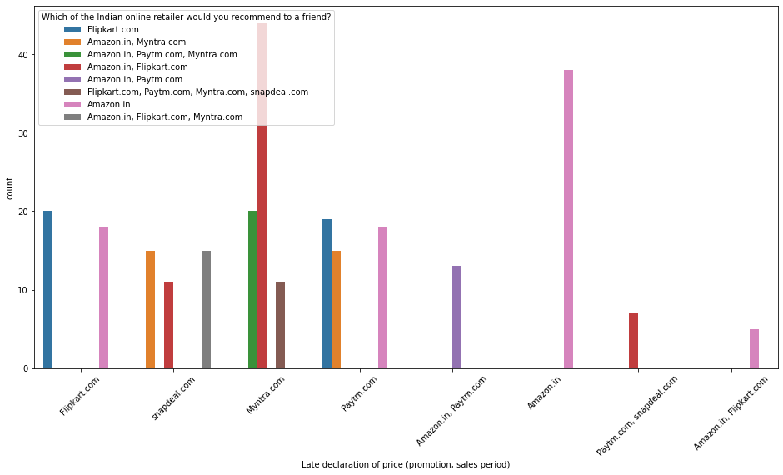
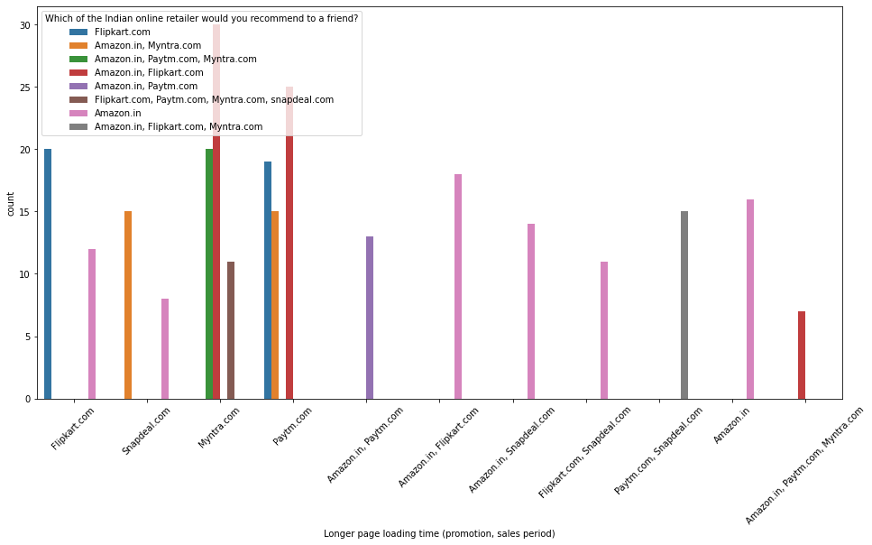
Bivariate Analysis
Amazon and Flipkart declares their promotion sales period late
Amazon, Flipkart, Paytm and Myntra has longer page loading time

Slide 18
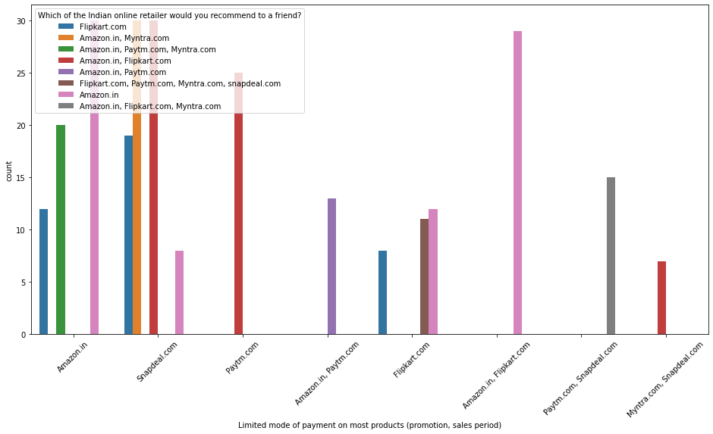
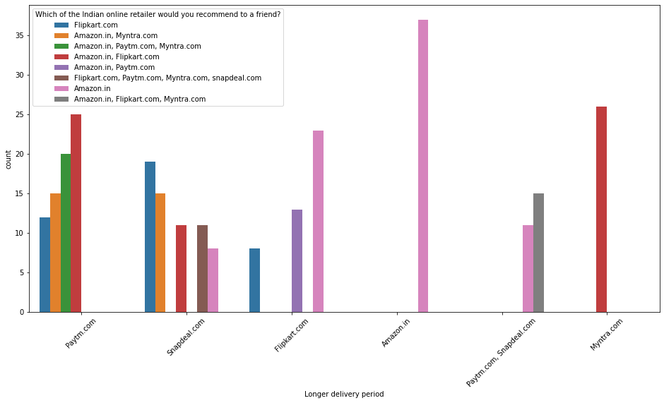
Bivariate Analysis
Amazon and Flipkart have limited mode of payment on most products
Majority of people thinks Amazon has longer delivery product

Slide 19
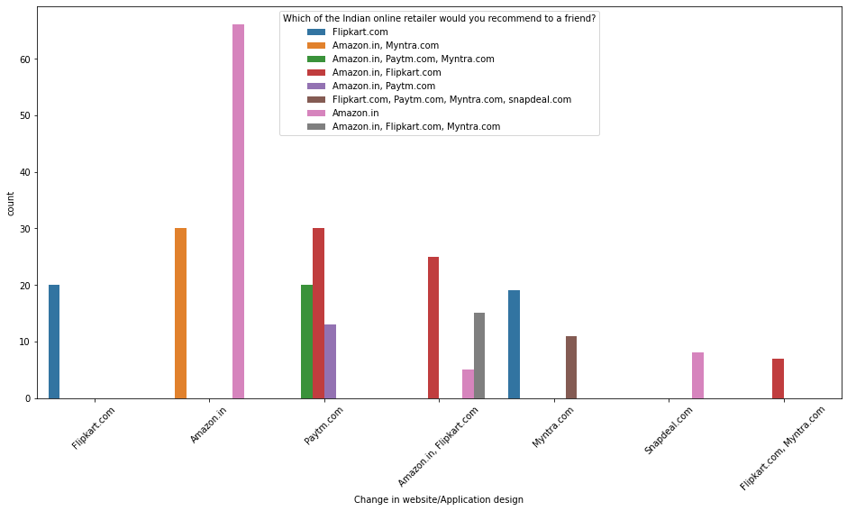
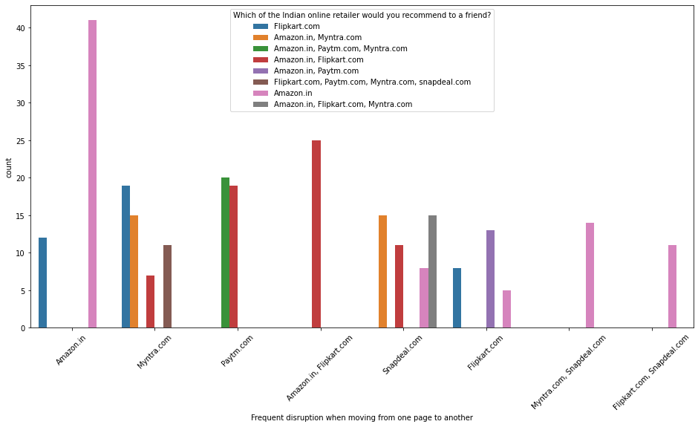
Bivariate Analysis
Majority thinks Amazon undergo lot of change in website/application
Amazon leads in frequent disruption while altering pages

Slide 20
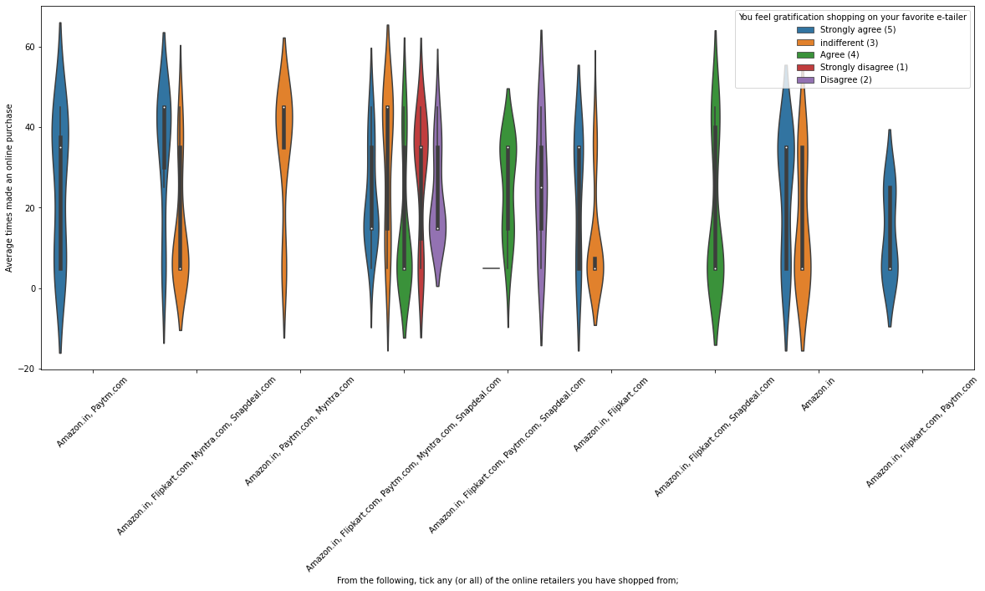
Multivariate Analysis
Almost all the people who have shopped from Amazon, Flipkart and Paytm are satisfied. People who shop from all the online brands doesn’t seem to be satisfied

Slide 21
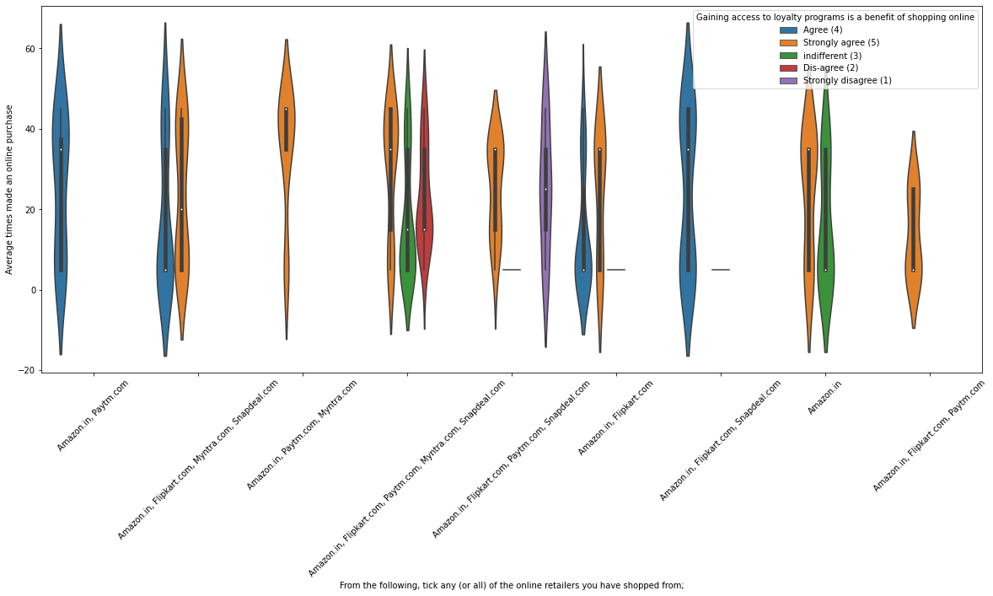
Multivariate Analysis
People shopping from amazon and Paytm are getting benefits from the loyalty points, Flipkart and Snapdeal also seem to give such benefits but people who shop from almost everywhere disagree with this statement too

Slide 22
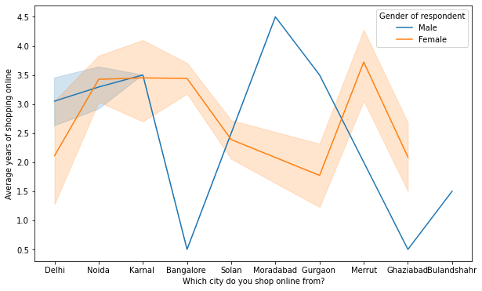
Multivariate Analysis
In lines, we can see that density of female customers is more than male
Men living in Bangalore and Ghaziabad shop have shopped online for less than 1 year
Highest number of men shopping online belong from Delhi and Noida, while men from Moradabad have been shopping online for the longest
Women from Meerut and Noida have shopped the longest

Slide 23
Conclusion
Amazon, Flipkart have been had the highest votes for having all the positive points and have maintained a very good brand image followed by Paytm and the Myntra
Customers seem to be more loyal to Amazon, Flipkart and Paytm as even though many of them have given negative remarks about them still they would recommend these platforms to their friend

